Slide 1
OPRATING SYSTAM
INTERDOUCTION

Slide 3
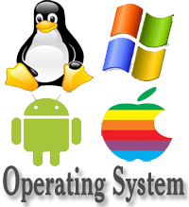
Some useful operating system

Slide 4
Defition an operating system is group program which control the computer recurse such that CPU I/O device etc and provide with an interface to make easy to use computer block diagram

Slide 5
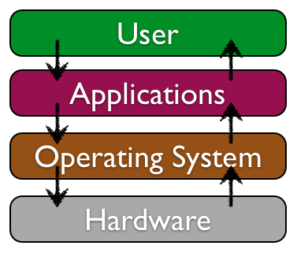
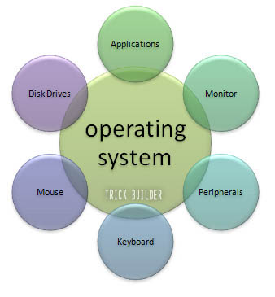
This Photo by Unknown Author is licensed under CC BY

Slide 8
THANK YOU

